Slide 1
Transgender Individuals
and HIV disease
Rachel L. Levine, MD
Physician General
@PhysGenLevine

Slide 2
Terms
LGBTQQIAA+
Gender Roles
Sexual Orientation
Gender Identity and expression

Slide 3
Terms
Difference between sexual orientation and gender identity
Sexual orientation and gender identity are separate concepts, and it is important to understand both.
A transgender person might consider themselves straight
Sexual Orientation
Gender Identity

Slide 4
Terms
The difference between Sex and Gender
Sex is the physical expression of genes.
Gender is the concept of self perception and how one relates to another in society (masculine vs. feminine).
The organic basis of gender identity may be a reflection of neurodevelopment of the brain.

Slide 5
Terms
Transgender
Describes people whose gender identity differs from their sex assigned at birth
Cisgender
A person who is not transgender

Slide 6
Terms
Transgender spectrum
Male-to-Female –MTF - Transgender Women
Female-to-Male – FTM – Transgender Man
Crossdresser
Transgender
Transsexual
Other terms – Genderqueer, Gender Fluid, etc.

Slide 7
Disparities
Stigma and Discrimination
Transgender people experience very high rates of stigma and discrimination
The National Transgender Discrimination Survey, 2011 found
55% had lost a job due to bias
51% harassed/bullied in school
61% victim of physical assault
64% victim of sexual assault
41% had suicide attempt (compared to 5.6 – 14.3% of US adults

Slide 8
Health Disparities
Transgender individuals face particular disparities
HIV/STDs – up to 28% of transgender women test positive for HIV
Victimization – at least 21 transgender people were murdered in 2015
Suicide – 41% had suicide attempt (compared to 5.6 – 14% of US adults)
Are less likely to have health insurance than heterosexual or LGB individuals.
59% of avoided bathrooms out of fear
Healthy People 2020

Slide 9
Contributing causes of disparity
Contributing cause of disparity
According to Healthy People 2020 the social determinants affecting the health of LGBT individuals are largely related to oppression and discrimination
Legal discrimination in access to health insurance, employment, housing, marriage, adoption, and retirement benefits
Lack of laws protecting against bullying in schools
Lack of social programs targeted to and/or appropriate for LGBT youth, adults, and elders

Slide 10
Contributing causes of disparity
Barriers to accessing health care
Stigma, including outright refusal of care or inadequate care.
Provider knowledge and training.
Lack of health insurance, due to low employment rates and denial of marriage equality.
Fear of talking with a doctor about sexuality or sexual health.

Slide 11
Disparities
HIV Disease
Men who have sex with men represent 2/3 of new HIV infections.
Young people, ages 13-24, are 16% of US population but account for 26% of all new HIV infections.
In 2009 newly identified HIV infection was 2.6% among transgender persons compared with 0.9% for cisgender males and 0.3% for cisgender women.
It is estimated that 28% of transgender women test positive for HIV infection.
One study found that 73% of transgender women who tested positive were unaware for their status.

Slide 12
Transgender people and HIV
Transgender people and HIV
Increased risk factors
High-risk sex including sex work
Injecting hormones without safe injecting practices
Stress of social isolation can lead to increase substance use disorder
Increased risk of violence, including intimate partner violence
Barriers to treatment
One study of people living with HIV in the USA found that only 59% of transgender patients, compared to 82% of those with a birth-assigned gender, were accessing ART
Up to 73% of transgender women are unaware of status

Slide 13
HIV and opioid crisis
Current opioid crisis puts PA at risk for increase HIV and HCV
HIV outbreak in Indiana was linked to injection drug users
In 2015, 3,505 drug-related overdose deaths were reported in PA, an increase of 30% from 2014

Slide 14
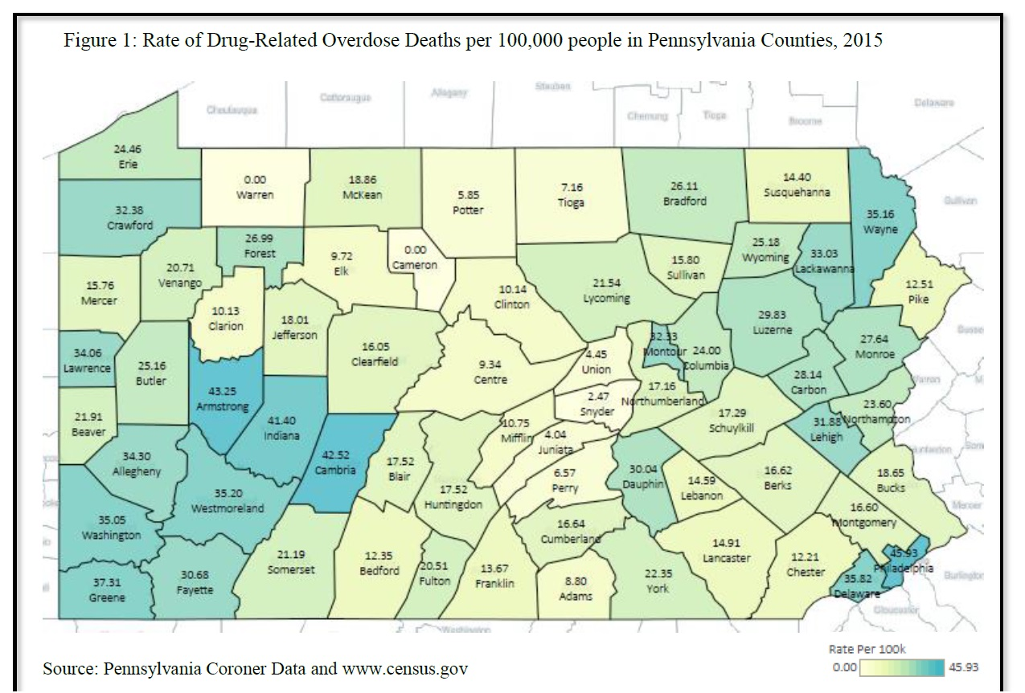
Heroin and Prescription Opioid Overdose Crisis
Rate in urban county of Philadelphia is 45.93 per 100,000
Rate in rural Cambria county is 42.52 per 100,000

Slide 15
Heroin and Prescription Opioid Overdose Crisis
State’s response is all-hands-on-desk
Focus on prevention - Opioid stewardship
Focus on Treatment – including MAT at Centers of Excellence

Slide 16
PrEP
Pre-Exposure Prophylaxis (PrEP)
A daily pill to reduce risk of HIV
Recommended for those HIV-negative and at very high risk of HIV infection
In May 2014 US Public Health Service and CDE issued clinical practice guidelines

Slide 17
PEP
Post-Exposure Prophylaxis (PEP)
PEP involves taking anti-HIV medication as soon as possible after potential exposure
Must be taken within 72 hours
PEP is taken once or twice daily for 28 days

Slide 18
Transgender Medicine
Transgender Medicine -
In the Diagnostic and Statistical Manual of Mental Disorders (DSM-5), people whose gender at birth is contrary to the one they identify with will be diagnosed with Gender dysphoria.
This diagnosis is a revision of DSM-IV’s criteria for Gender identity disorder.
Marked difference between the individual’s expressed/experienced gender and the gender others would assign him or her, and it must continue for at least six months.

Slide 19
Transgender Medicine
In children, the desire to be of the other gender must be present and verbalized.
This condition causes clinically significant distress or impairment in social, occupational, or other important areas of functioning.
The DSM-5 diagnosis adds a post-transition specifier for people who are living full-time as the desired gender (with or without legal sanction of the gender change).

Slide 20
Transgender Medicine
Standard of Care
The World Professional Association for Transgender Health, INC
www.wpath.org
New revision pending
Evaluation and treatment of transsexual patients
Psychological evaluation – treatment
Medical evaluation
Hormonal therapy
Surgical therapy

Slide 21
Transgender Medicine
WPATH Standards of Care
Eligibility criteria for hormonal gender reassignment.
Demonstrate knowledge of what hormones can and cannot do and their social benefits and risks.
A mental health evaluation is still a requirement for referral for hormone therapy.
A period of psychotherapy is now recommended but not required.
Recommended that patients live as the other gender for 12 months before genital surgery.
Age considerations.

Slide 22
Transgender Medicine
Treatment
Reasons for hormone therapy
Cross-sex hormonal treatments play an important role in the anatomical and psychological gender transition process.
Hormones are often medically necessary for successful living in the new gender.
They improve the quality of life and limit psychiatric co-morbidity, which often accompanies lack of treatment.

Slide 23
Transgender Medicine
Hormone replacement therapy- HRT
Male-to-Female (MTF)
Anti-androgens
Estrogens
Female-to-Male (FTM)
Androgens
Benefits and side effects

Slide 24
Transgender Medicine
Endocrine Treatment of Transsexual Persons: An Endocrine Society Clinical Practice Guideline, Hembree et al, J.Clinical Endocrinology and Metabolism, 9/2009, 94(9): 3132-3154
Establishes clinical guidelines for medical evaluation, hormonal treatment and follow-up of transsexual adolescents and adults.
Accepted by the Endocrine Society, European Society of Endocrinology, WPATH and others.

Slide 25
Transgender Medicine
Anti-Androgens:
Block the production and effects of testosterone.
Testosterone must be blocked for estrogen to work
Use allows a lower dose of estrogen to be used to produce the same feminization but reduce the risks of estrogen.
Many different kinds but many are expensive.
Spironolactone- 100-300 mg.

Slide 26
Transgender Medicine
Estrogens for MTF
Estradiol (Estrace) 0.5 to 6.0mg.
IM Estradiol
Estradiol Transdermal (Fempatch, Alora, Climara, Estraderm, Vivelle Microdot) 0.1 to 0.2.
Estrogel
Topical compounded estradiol cream

Slide 27
Transgender Medicine
Estrogen - Effects
Skin Changes—finer skin, thin nails
Female fat distribution: Abdomen to breasts and hips
Muscle changes-loss of 30% muscle mass
Breast development max in two years (2/3 mothers size at age 21, older less development)
Decrease hair loss, sometimes regrowth scalp hair
Decreased body hair in two years (between breasts)
Improvement in mood
Heightened sensitivity to smell and color

Slide 28
Transgender Medicine
Side Effects of Estrogen
Excessive breast tenderness or discharge
Pituitary tumors and Hyperprolactinemia
Risk of thromboembolic events (particularly first year of HRT)
High blood pressure secondary to fluid and salt retention
Breast cancer
Decreased libido, loss of erections, infertility (IMPOTENCE)

Slide 29
Transgender Medicine
Testosterone for FTM
Oral testosterone is metabolized in the gut and quickly inactivated in the liver.
Usually given as an intramuscular injection.
Testosterone cypionate 100-200 mg. IM q 2 weeks.
IM shots interval may cause some mood fluctuations and a change in the interval of dosing can help this.
Topical- Androgel, Testosterone Creams

Slide 30
Transgender Medicine
Changes on testosterone in FTM
First changes are deepening of the voice in about 1-3 months
Periods cease within 1-2 months (titration) with IM shots- Cream takes 6-8 months
Muscle mass increases about 30%, reduces fat and redistributes fat to male pattern
Facial hair develops in 6-24 months and may take five years to maximize. Highly individual results
Male pattern balding can develop
Acne can develops
Clitoral enlargement
Fertility Issues

Slide 31
Transgender Medicine
Trans – Teens
There are the issues of puberty which can be devastating to a MTF trans-teen with changes of facial hair, changes in stature and bone structure, as well as deepening of the voice.
In the young FTM, the onset of menses and breast development can also be terrifying and depressing.
The incidence of suicidal thought and depression is very high particularly if there is not good family support.

Slide 32
Transgender Medicine
Standards of care (age less than 18)
Recommends no medical treatment for prepubertal children with Gender Dysphoria.
Adolescents are eligible for medical treatment if they meet the following criteria:
Fulfill DSM criteria for Gender Dysphoria
At least Tanner Stage 2
No serious psychiatric co-morbidity that interferes with treatment
Have adequate support during treatment
Demonstrate understanding of the treatment

Slide 33
Transgender Medicine
Standards of care (age less than 18)
Protocol developed in the Netherlands
Hormonal treatment should be conducted in two phases:
Initial Phase
MTF – Pubertal Blocker
FTM – Pubertal Blocker
Second Phase
MTF may be given estrogenic agents
FTM may be given masculinizing doses of androgens

Slide 34
Transgender Medicine
Trans-Teens
Follow-up Protocols established
Usually no surgery before age 18
There are exceptions based on individual cases

Slide 35
Transgender Medicine
Gender Confirmation Surgery
Previously called Sexual reassignment surgery
MTF
FTM
FFS- Facial Feminization surgery
Changes in dose of hormones
Don’t Assume all patients want surgery!

Slide 36
Creating welcoming practice for LGBTQ patients
Avoid Assumptions
Don’t Assume
All patients are heterosexual
All patients use traditional labels
Sexual orientation or gender identity based on appearance
That a patients sexual orientation or gender identity is only a phase
Sexual behavior or gender identity hasn’t changed since last visit
The Fenway Institute

Slide 37
Creating welcoming practice for LGBTQ patients
Taking a history of sexual health
“Ironically, it may require greater intimacy to discuss sex than to engage in it.”
The Hidden Epidemic Institute of Medicine, 1997
Use inclusive and neutral language
Who are you attracted to?
Are you in a relationship?
Don’t make assumptions about sexual activities
Don’t make assumptions about reproductive goals

Slide 38
Creating welcoming practice for LGBTQ patients
The Clinician’s Role
Assist patients in healthy discovery, autonomy, and self-acceptance.
Make the clinical environment safe, accessible, and welcoming to LGBT patients.
Importance of education about LGBT issues for nurses and ALL staff

Slide 39
Creating welcoming practice for LGBTQ patients
The Clinician’s Role
Create an open and honest dialogue
Ask non-judgmental questions about sexuality, sexual identity, and gender identity of all patients.
Respect confidentiality while working with patients to find sources of support at home or in their community.
Be prepared with referrals and resources.

Slide 40
Questions???
QUESTIONS?
@PhysGenLevine

